Slide 1

Reduced Academic Momentum:
Select Conditions for Learning Data
February 17, 2021

Slide 2




Data Available on Academic, Social, and Emotional Momentum
2020-21
Enrollment Patterns
Chronic Absenteeism
Course Failures
Graduation On-Track
Staff, Family, Student Voice
T1 Staff Survey (N=3,756)
T1 Family Survey (N=18,382)
T1 Student Townhalls (N=350)
Coming Soon: ACT, Student Climate Survey, ACCESS…and SBAC?

Slide 3
Observations, Wonderings
In the chat box:
1-2 things you observe (facts)
1-2 things you wonder (reaction, interpretation)
But don’t press send until section ends

Slide 4
Data Connections:
Family Perceptions, Absenteeism, Failure Rates
 | Family Attitudes towards Distance Learning | Family Attitudes towards In-Person Learning | In Person Learning Student Engagement | Distance Learning Student Engagement | Student Relationships with Teachers/Staff | Family Well-Being | Chronic Absenteeism Rates | Course Failure Rates
Asian | 13 | 3 | 1 | 17 | 8 | 4 | 23 | 18
Black | 2 | -8 | -9 | 1 | -3 | -6 | 54 | 41
Hispanic | 6 | 5 | -4 | 11 | 7 | 8 | 46 | 41
American Indian | 3 | 3 | 0 | 4 | 7 | 0 | 52 | 46
Pacific Islander | 2 | 4 | 8 | 9 | 5 | 1 | 57 | 49
White | 0 | 3 | 2 | -4 | 3 | -1 | 28 | 23
Multiracial | 4 | 0 | 0 | -3 | 2 | 1 | 34 | 27

Slide 5
Data Connections:
Family Perceptions, Absenteeism, Failure Rates
 | Family Perceptions of COVID-19 Safety | Family Perceptions of Distance Learning | Family Perceptions of In-Person Learning | Family Relationships with Teachers and Staff | Family Well-Being | Chronic Absenteeism | School Level Course Failure Rates
Kindergarten | 7 | 26 | 17 | 23 | 21 | 22 | --
1st | 9 | 25 | 16 | 24 | 16 | 22 | --
2nd | 7 | 23 | 15 | 21 | 16 | 21 | --
3rd | 8 | 24 | 14 | 23 | 16 | 19 | 9
4th | 7 | 22 | 12 | 22 | 14 | 22 | 9
5th | 5 | 23 | 9 | 20 | 12 | 23 | 9
6th | -2 | -6 | -1 | -12 | -8 | 41 | 26
7th | -4 | -3 | -3 | -13 | -8 | 47 | 26
8th | -3 | -2 | -6 | -11 | -8 | 46 | 26
9th | -3 | -4 | -11 | -19 | -14 | 52 | 38
10th | -4 | -4 | -11 | -17 | -13 | 52 | 38
11th | -6 | -2 | -12 | -15 | -12 | 55 | 38
12th | -5 | -1 | -11 | -12 | -9 | 62 | 38

Slide 6

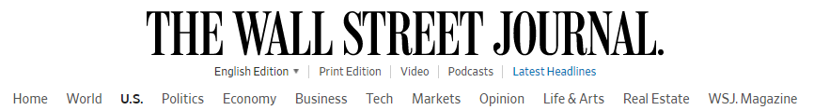
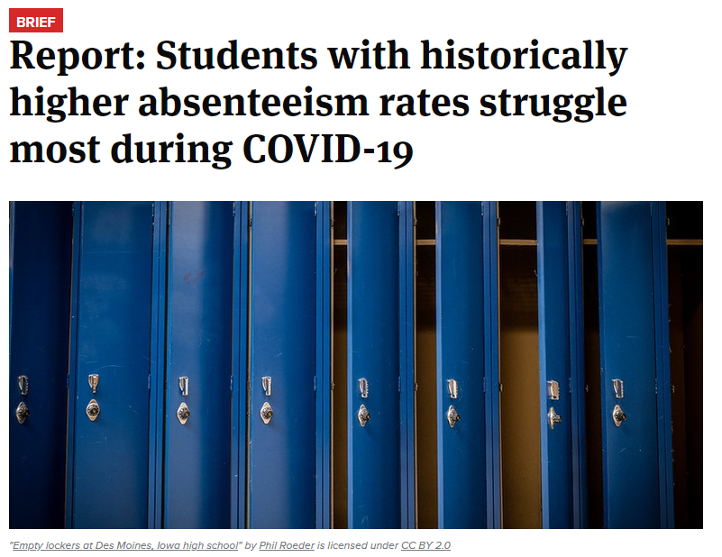
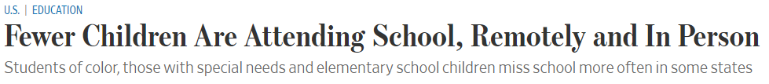



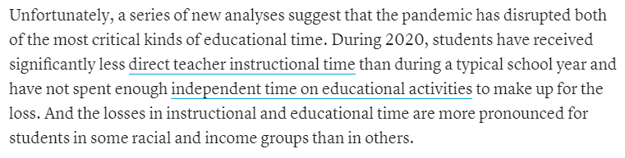
Reduced Momentum Nationwide

Slide 7
Staff Work Stress

Slide 8
Words Students Use to Describe School This Year

Slide 9
Staff, Family, and Student Feedback
(Emotional Well-Being)
Staff: “I have never been in such a hopeless, exhausted, emotionally deficient atmosphere as I am in now.” Staff worry about their students’ well-being, “The level of trauma and lack of resources seems to be severely under appreciated. The students are watching siblings and dealing with abuse.”
Families: “My child isn't adapting well to the distance learning and not getting any one on one time with the teacher. She is falling behind and is no longer invested in learning.” Even in-person learners are affected, “[My child’s] daily anxiety of them possibly coming home sick. It distracts them from focusing on schoolwork.”
Students: “I'm not emotionally healthy…But if I listen to music I'm okay for a little while.”
They want more opportunities to connect with teachers and their peers, but struggle asking for help, “A few days ago, my teacher asked a few people if they were ok and we all said good because it’s hard to tell everyone how you feel. Especially in front of everyone in that zoom.” Students want to reach out to other students who need support, but need a platform.
(#notalone #wearehereforyou #howareyoureally?! #Y'allAreTheFirstHumansI'veSeenInALongTime)

Slide 10
Staff, Family, and Student Feedback
(COVID Barriers to Learning)
Staff: “Parents’ lack of concern over student absences…Contact with parents/guardians fewer answer phones, return call and/or emails.
Families: “A lot of school work is very stressful, my son has more than 200 assignments because we only had one computer for the family of 2 children at school in addition to having to have been ill with symptoms of possible covid.”
Students: “I don’t know if it’s possible to have teachers communicate more with students and hopefully reach out more…I feel like it relies on students to reach out, when I know some children have a hard time reaching out because they don’t know what to say.”
(#BetterConnections #socialazation #wemissconnections #SocialDistanceFriends)

Slide 11
Staff, Family, and Student Feedback
(In-Person COVID Barriers to Learning)
Staff: “Meaningful teaching and learning cannot happen when students and teachers are wearing masks and have to social distance. My [English Learner] students need to see my mouth and hear my voice for correct pronunciation of sounds. My voice is muffled, and I have a hard time hearing them when they speak to me.”
Families: “Wearing masks and social distancing. Taking away from small group instruction and partner conversation.”

Slide 12
Staff, Family, and Student Feedback
(Strengths of Learning)
Staff: “Student laughter can be heard both in class and virtually. May seem silly but it is the reason we walk into our buildings every day!”
Families: “His orchestra teacher has gone above and beyond. She has included distance learners via zoom into her existing classes. She assigns practices and keeps in touch via teams. All students are included in fun classroom rivalries and games and she zooms with them every class day. He's thriving in that class, and what a treasure to have orchestra offered to distance learners through the hard and extra work of this teacher.”
Students: “I would say that persistent teachers create persistent students…if teachers are reaching out and trying to make sure like, ‘Hey, are you okay? How is your family?’ And then trying to piece in like, ‘Hey, you got a couple of assignments that are overdue or stuff like that’…not only are you cared for as a student, you’re cared for as a person, and it makes you feel like you matter.”
(#HelpTheTeachersToo #ThankTheTeachers)

Slide 13
Observations, Wonderings
In the chat box:
1-2 things you observe (facts)
1-2 things you wonder (question, interpretation)
But don’t press send until section ends

Slide 14


Impact on Student Engagement and Learning

Slide 15
Family Perceptions of Learning Model Effectiveness

Slide 16
Staff Perspectives on Student Engagement

Slide 17
Family Perspectives on Student Engagement

Slide 18
Family Concerns
Percent of families "very" or "extremely" concerned about their child’s academic growth, Spring 2019-20 & Fall 2020-21.
15 ppt. increase
14 ppt. increase
14 ppt. increase
13 ppt. increase
Sources: Family School Reopening Survey (Fall 2020-21) and Distance Learning & Well-Being Survey (Spring 2019-20)

Slide 19
Actions!
In chat box:
What are implications for your work group:
  -Questions for future study
  -Change ideas

Slide 20

Challenges and Solutions
(Educators and Families)

Slide 21
Top Challenges
Top Challenges Staff Report Facing |  | Top Challenges Families Report Facing
38% | Devices and technology platforms are inadequate | 33% | Poor instructional quality and inconsistent teaching practices
30% | Stress, burnout, workload, feeling under-valued | 18% | Emotional well-being, isolation, anxiety, depression
21% | Difficulty of teaching multiple learning models | 10% | Technology challenges (multiple platforms, glitches)
12% | Safety protocols negatively impacting learning | 8% | COVID-19 and safety measures negatively impacting learning
8% | Difficulty engaging students and families on distance learning | 6% | School communication
 |  | 3% | Competing home demands
 |  | 2% | Inaccurate record of attendance and assignments

Slide 22
Top Solutions
Top Solutions Staff Request |  | Top Solutions Families Request
38% | Provide better technology and platforms for students and staff | 18% | Improve instruction: -More “live” instruction -Consistent A/B instruction -Timely feedback from teachers
16% | Suspend time-consuming activities (SLOs, assessments, attendance) | 16% | Open schools full-time to improve learning and emotional well-being
16% | Provided dedicated DL teachers, reduce # of models | 12% | Streamline technology platforms and increase technology access
12% | Secure more funding for public education (positions, compensation) | 7% | Adhere to or remove safety measures
7% | Provide more prep periods/days for teachers

Slide 23
Top Strengths
Top Strengths Staff Report |  | Top Strengths Families Report
38% | Staff teamwork | 14% | Academic and emotional growth
29% | Strong school-based leadership | 13% | Supportive schools, caring staff
16% | Smaller class sizes | 10% | Household and student assets (family bonding, self-discovery)
16% | Students following safety protocols | 5% | Technology supporting learning
 |  | 5% | School communication

Slide 24

Current Supports
Questions?

